Slide 1
ETL Project
By: Todd Schanzlin, John Swierczynski, & Erin Lee

Slide 2
Extract
Source: https://www.kaggle.com/datasets
For this project we used 4 csv files and loaded them into DataFrames:
Astronauts.csv
Biographical and mission data for each NASA astronaut from 1959
Space_walks.csv
US and Russian extra-vehicular activity (“EVA”) from 1965
Space_missions.csv
Equipment, mission, and launch location / date information from 1957
Global_space_launches.csv
Equipment, mission, and launch location / date information from 1957

Slide 3
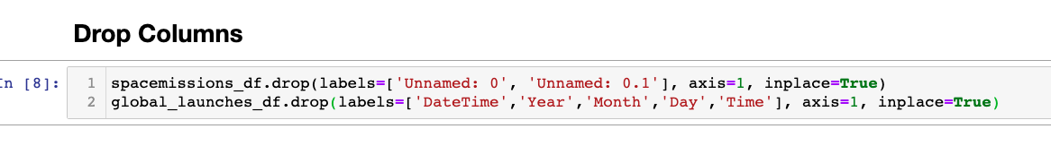
Transform
We first cleaned the data by dropping unwanted columns.

Slide 4
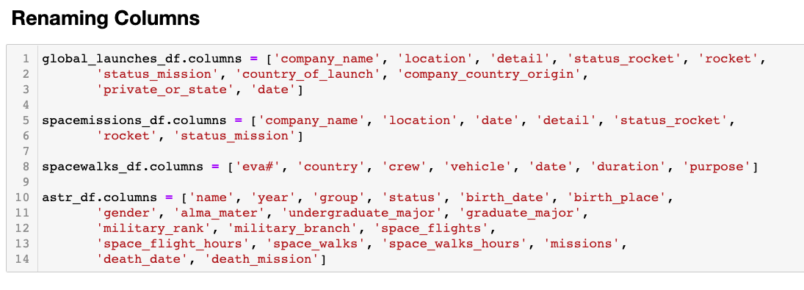
Transform
We finished cleaning our data by renaming columns

Slide 5
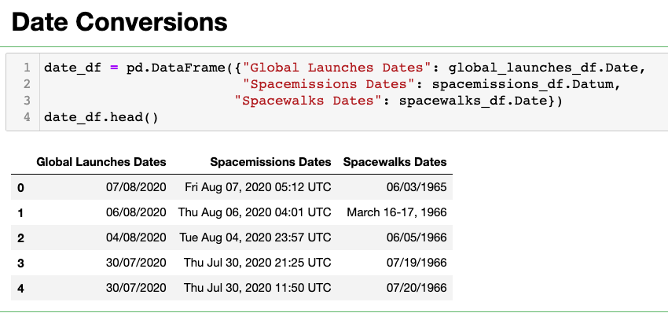
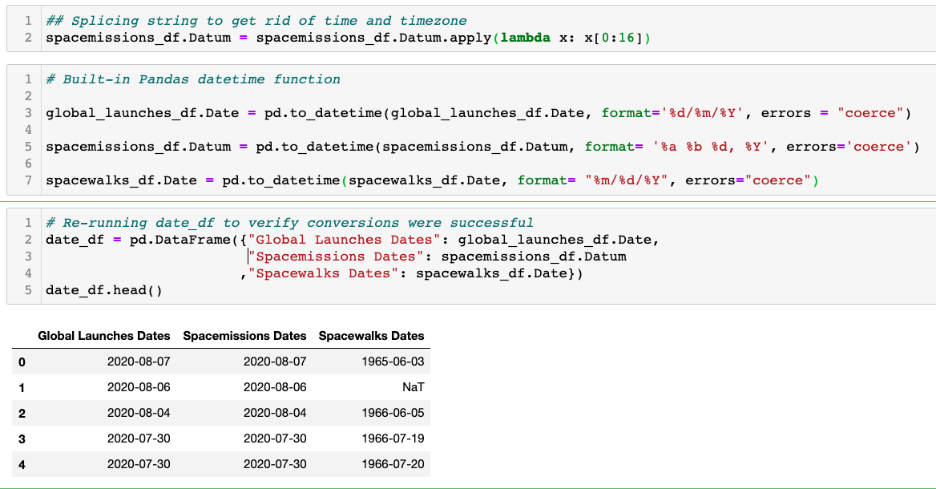
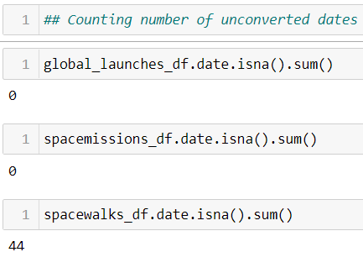
Transform
We then converted the dates so that they would be in the same format
To verify that all entries were converted, we checked for null values
The spacewalks df had 44 unconverted “null” entries

Slide 6
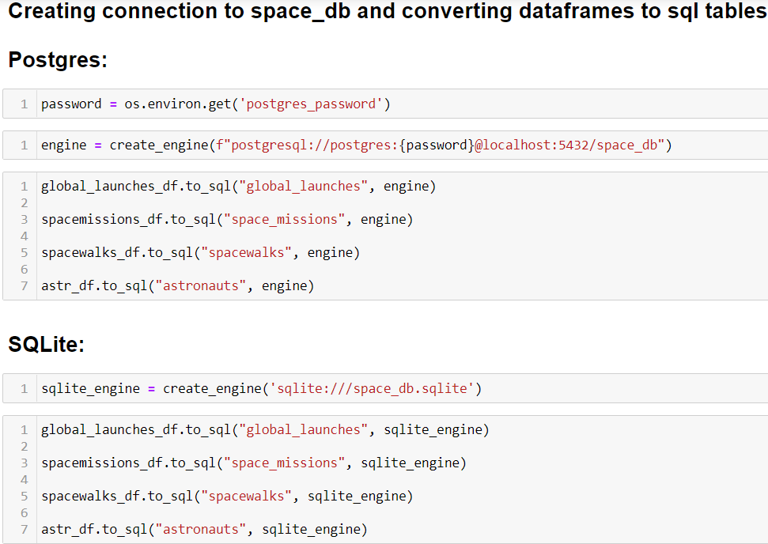
Load
We used pandas to sql to load our data into a Postgres database
We also imported the dataframes into a SQLite database

Slide 7
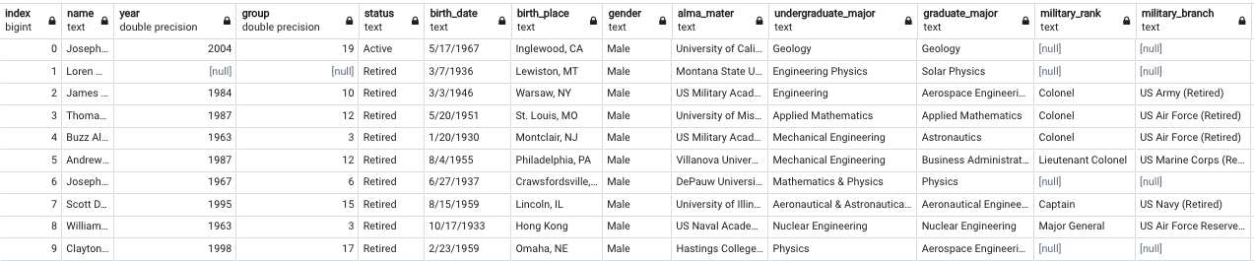
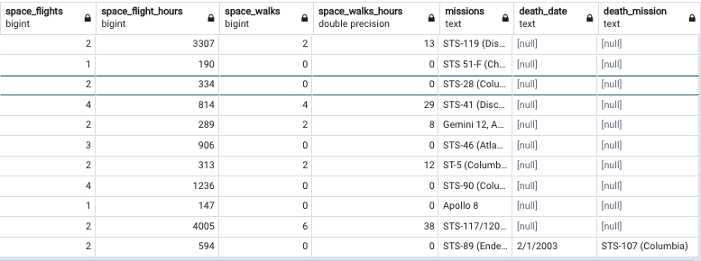
Astronauts

Slide 8
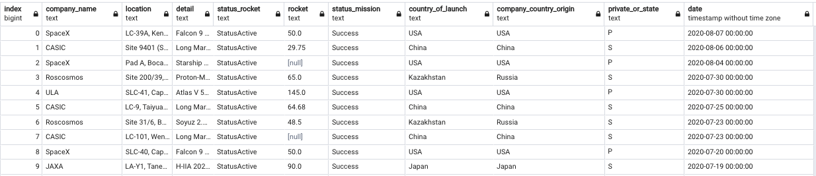
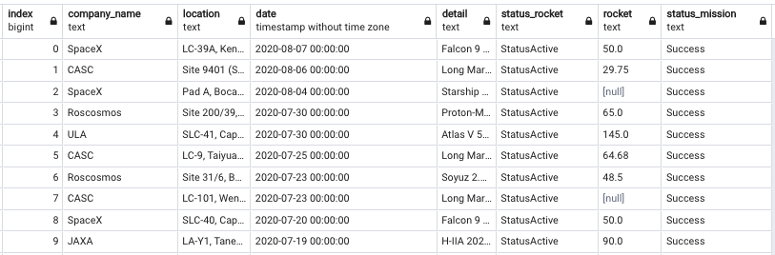
Global Launches
Space Missions

Slide 9
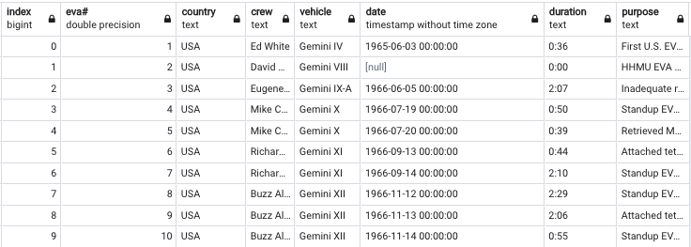
Spacewalks

Slide 10
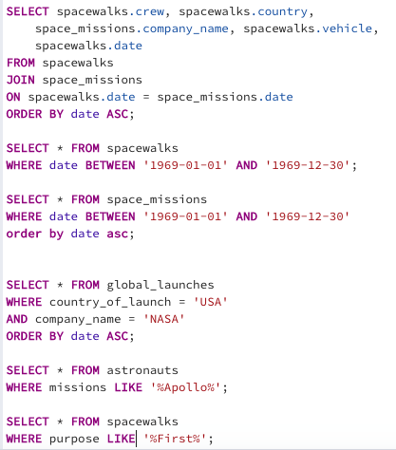
Queries

Slide 11
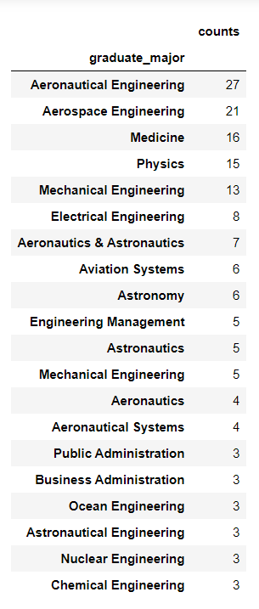
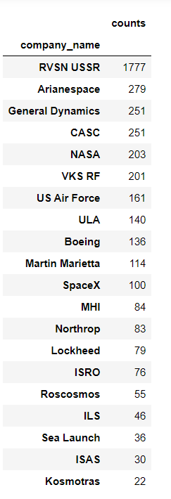
NASA Astronauts (1959-Present)
Company Responsible for Launch
We used the Pandas groupby function to explore the top 20 most common graduate majors among all NASA astronauts
Similarly, we found the top 20 companies who have sent the greatest amount of spacecraft into space

Slide 12
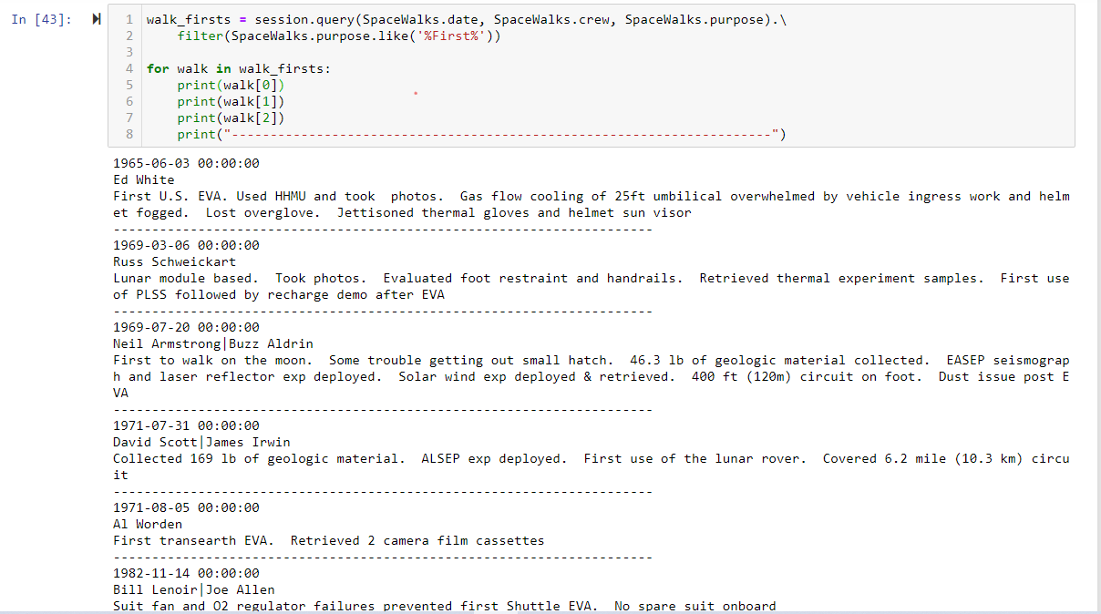
Spacewalk Firsts
We were also able to search the data using SQLAlchemy to observe US Spacewalk firsts

